Slide 1
ASP.Net and C#
Lecture 3(17-08-2023)
Topic:
C# introduction
Variables
datatypes

Slide 2
What is C#
C# is pronounced as "C-Sharp". It is an object-oriented programming language provided by Microsoft that runs on .Net Framework.
By the help of C# programming language, we can develop different types of secured and robust applications:
Window applications
Web applications
Distributed applications
Web service applications
Database applications etc.
C# is approved as a standard by ECMA and ISO. C# is designed for CLI (Common Language Infrastructure). CLI is a specification that describes executable code and runtime environment.
C# programming language is influenced by C++, Java, Eiffel, Modula-3, Pascal etc. languages.

Slide 3
Java vs C#
There are many differences and similarities between Java and C#. A list of top differences between Java and C# are given below:
No.0 | Java | C#
1) | Java is a high level, robust, secured and object-oriented programming language developed by Oracle. | C# is an object-oriented programming language developed by Microsoft that runs on .Net Framework.
2) | Java programming language is designed to be run on a Java platform, by the help of Java Runtime Environment (JRE). | C# programming language is designed to be run on the Common Language Runtime (CLR).
3) | Java type safety is safe. | C# type safety is unsafe.

Slide 4
4) | In java, built-in data types that are passed by value are called primitive types. | In C#, built-in data types that are passed by value are called simple types.
5) | Arrays in Java are direct specialization of Object. | Arrays in C# are specialization of System.
6) | Java does not support conditional compilation. | C# supports conditional compilation using preprocessor directives.
7) | Java doesn't support goto statement. | C# supports goto statement.
8) | Java doesn't support structures and unions. | C# supports structures and unions.
9) | Java supports checked exception and unchecked exception. | C# supports unchecked exception.

Slide 5

C# History
History of C# language is interesting to know. Here we are going to discuss brief history of C# language.
C# is pronounced as "C-Sharp". It is an object-oriented programming language provided by Microsoft that runs on .Net Framework.
Anders Hejlsberg is known as the founder of C# language.
It is based on C++ and Java, but it has many additional extensions used to perform component oriented programming approach.
C# has evolved much since their first release in the year 2002. It was introduced with .NET Framework 1.0 and the current version of C# is 5.0.
Let's see the important features introduced in each version of C# are given below.

Slide 6
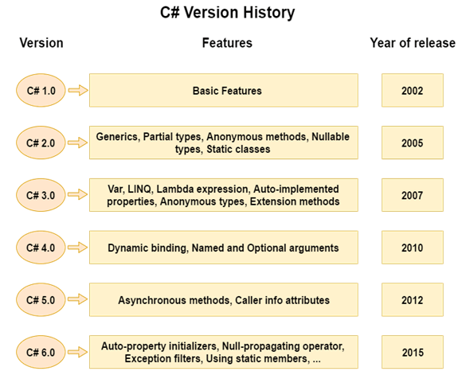

Slide 7
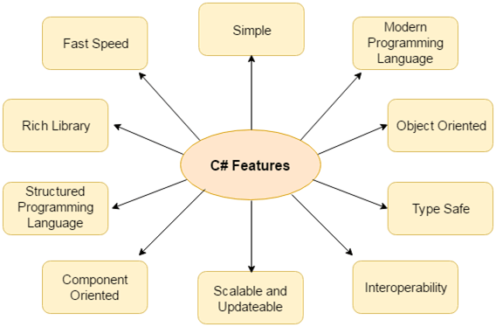
C# Features
C# is object oriented programming language. It provides a lot of features that are given below.
Simple
Modern programming language
Object oriented
Type safe
Interoperability
Scalable and Updateable
Component oriented
Structured programming language
Rich Library
Fast speed

Slide 8
1) Simple
C# is a simple language in the sense that it provides structured approach (to break the problem into parts), rich set of library functions, data types etc.
2) Modern Programming Language
C# programming is based upon the current trend and it is very powerful and simple for building scalable, interoperable and robust applications.
3) Object Oriented
C# is object oriented programming language. OOPs makes development and maintenance easier where as in Procedure-oriented programming language it is not easy to manage if code grows as project size grow.
4) Type Safe
C# type safe code can only access the memory location that it has permission to execute. Therefore it improves a security of the program.
5) Interoperability
Interoperability process enables the C# programs to do almost anything that a native C++ application can do.

Slide 9
6) Scalable and Updateable
C# is automatic scalable and updateable programming language. For updating our application we delete the old files and update them with new ones.
7) Component Oriented
C# is component oriented programming language. It is the predominant software development methodology used to develop more robust and highly scalable applications.
8) Structured Programming Language
C# is a structured programming language in the sense that we can break the program into parts using functions. So, it is easy to understand and modify.
9) Rich Library
C# provides a lot of inbuilt functions that makes the development fast.
10) Fast Speed
The compilation and execution time of C# language is fast.

Slide 10
C# Example: Hello World
In C# programming language, a simple "hello world" program can be written by multiple ways. Let's see the top 4 ways to create a simple C# example:
Simple Example
Using System
Using public modifier
Using namespace
C# Simple Example
class Program
{
static void Main(string[] args)
{
System.Console.WriteLine("Hello World!");
}
}
Output:
Hello World!

Slide 11
Description
class: is a keyword which is used to define class.
Program: is the class name. A class is a blueprint or template from which objects are created. It can have data members and methods. Here, it has only Main method.
static: is a keyword which means object is not required to access static members. So it saves memory.
void: is the return type of the method. It does't return any value. In such case, return statement is not required.
Main: is the method name. It is the entry point for any C# program. Whenever we run the C# program, Main() method is invoked first before any other method. It represents start up of the program.
string[] args: is used for command line arguments in C#. While running the C# program, we can pass values. These values are known as arguments which we can use in the program.
System.Console.WriteLine("Hello World!"): Here, System is the namespace. Console is the class defined in System namespace. The WriteLine() is the static method of Console class which is used to write the text on the console.

Slide 12
C# Example: Using System
If we write using System before the class, it means we don't need to specify System namespace for accessing any class of this namespace. Here, we are using Console class without specifying System.Console.
using System;
class Program
{
static void Main(string[] args)
{
Console.WriteLine("Hello World!");
}
}
Output:
Hello World!

Slide 13
C# Example: Using namespace
We can create classes inside the namespace. It is used to group related classes. It is used to categorize classes so that it can be easy to maintain.
using System;
namespace ConsoleApplication1
{
public class Program
{
public static void Main(string[] args)
{
Console.WriteLine("Hello World!");
}
}
}
Output:
Hello World!

Slide 14
C# Example: Using public modifier
We can also specify public modifier before class and Main() method. Now, it can be accessed from outside the class also.
using System;
public class Program
{
public static void Main(string[] args)
{
Console.WriteLine("Hello World!");
}
}
Output:
Hello World!

Slide 15
C# Variable
A variable is a name of memory location. It is used to store data. Its value can be changed and it can be reused many times.
It is a way to represent memory location through symbol so that it can be easily identified.
The basic variable type available in C# can be categorized as:
Variable Type | Example
Decimal types | decimal
Boolean types | True or false value, as assigned
Integral types | int, char, byte, short, long
Floating point types | float and double
Nullable types | Nullable data types

Slide 16
Let's see the syntax to declare a variable:
type variable_list;
The example of declaring variable is given below:
int i, j;
double d;
float f;
char ch;
Here, i, j, d, f, ch are variables and int, double, float, char are data types.
We can also provide values while declaring the variables as given below:
int i=2,j=4; //declaring 2 variable of integer type
float f=40.2;
char ch='B';

Slide 17
Rules for defining variables
A variable can have alphabets, digits and underscore.
A variable name can start with alphabet and underscore only. It can't start with digit.
No white space is allowed within variable name.
A variable name must not be any reserved word or keyword e.g. char, float etc.
Valid variable names:
int x;
int _x;
int k20;
Invalid variable names:
int 4;
int x y;
int double

Slide 18
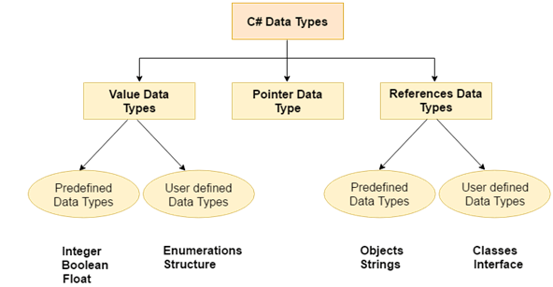
C# Data Types
A data type specifies the type of data that a variable can store such as integer, floating, character etc.

Slide 19
Types | Data Types
Value Data Type | short, int, char, float, double etc
Reference Data Type | String, Class, Object and Interface
Pointer Data Type | Pointers

Slide 20
Value Data Type
The value data types are integer-based and floating-point based. C# language supports both signed and unsigned literals.
OOPs Concepts in Java
There are 2 types of value data type in C# language.
1) Predefined Data Types - such as Integer, Boolean, Float, etc.
2) User defined Data Types - such as Structure, Enumerations, etc.
The memory size of data types may change according to 32 or 64 bit operating system.
Let's see the value data types. It size is given according to 32 bit OS.

Slide 21
Data Types | Memory Size | Range
char | 1 byte | -128 to 127
signed char | 1 byte | -128 to 127
unsigned char | 1 byte | 0 to 127
short | 2 byte | -32,768 to 32,767
signed short | 2 byte | -32,768 to 32,767
unsigned short | 2 byte | 0 to 65,535
int | 4 byte | -2,147,483,648 to -2,147,483,647
signed int | 4 byte | -2,147,483,648 to -2,147,483,647
unsigned int | 4 byte | 0 to 4,294,967,295
long | 8 byte | ?9,223,372,036,854,775,808 to 9,223,372,036,854,775,807

Slide 22
signed long | 8 byte | ?9,223,372,036,854,775,808 to 9,223,372,036,854,775,807
unsigned long | 8 byte | 0 - 18,446,744,073,709,551,615
float | 4 byte | 1.5 * 10⁻⁴⁵ - 3.4 * 10³⁸, 7-digit precision
double | 8 byte | 5.0 * 10⁻³²⁴ - 1.7 * 10³⁰⁸, 15-digit precision
decimal | 16 byte | at least -7.9 * 10^{?28} - 7.9 * 10²⁸, with at least 28-digit precision

Slide 23
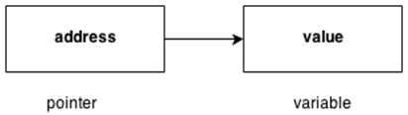
Reference Data Type
The reference data types do not contain the actual data stored in a variable, but they contain a reference to the variables.
If the data is changed by one of the variables, the other variable automatically reflects this change in value.
There are 2 types of reference data type in C# language.
1) Predefined Types - such as Objects, String.
2) User defined Types - such as Classes, Interface.
Pointer Data Type
The pointer in C# language is a variable, it is also known as locator or indicator that points to an address of a value.

Slide 24
Symbols used in pointer
Symbol | Name | Description
& (ampersand sign) | Address operator | Determine the address of a variable.
* (asterisk sign) | Indirection operator | Access the value of an address.
Declaring a pointer
The pointer in C# language can be declared using * (asterisk symbol).
int * a; //pointer to int
char * c; //pointer to char

Slide 25
C# operators
An operator is simply a symbol that is used to perform operations. There can be many types of operations like arithmetic, logical, bitwise etc.
There are following types of operators to perform different types of operations in C# language.
Arithmetic Operators
Relational Operators
Logical Operators
Bitwise Operators
Assignment Operators
Unary Operators
Ternary Operators
Misc Operators

Slide 26
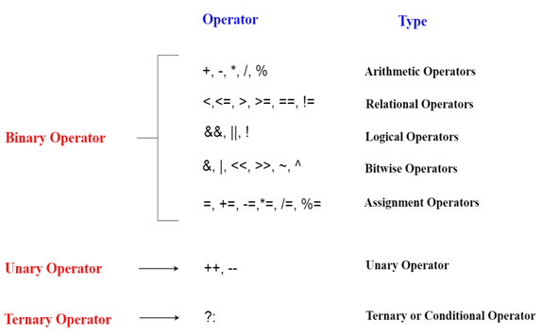

Slide 27
Precedence of Operators in C#
The precedence of operator specifies that which operator will be evaluated first and next. The associativity specifies the operators direction to be evaluated, it may be left to right or right to left.
Let's understand the precedence by the example given below:
int data= 10+ 5*5
The "data" variable will contain 35 because * (multiplicative operator) is evaluated before + (additive operator).
The precedence and associativity of C# operators is given below:

Slide 28
Category (By Precedence) | Operator(s) | Associativity
Unary | + - ! ~ ++ -- (type)* & sizeof | Right to Left
Additive | + - | Left to Right
Multiplicative | % / * | Left to Right
Relational | < > <= >= | Left to Right
Shift | << >> | Left to Right
Equality | == != | Right to Left
Logical AND | & | Left to Right

Slide 29
Logical OR | | | Left to Right
Logical XOR | ^ | Left to Right
Conditional OR | || | Left to Right
Conditional AND | && | Left to Right
Null Coalescing | ?? | Left to Right
Ternary | ?: | Right to Left
Assignment | = *= /= %= += - = <<= >>= &= ^= |= => | Right to Left

Slide 30
C# Keywords
A keyword is a reserved word. You cannot use it as a variable name, constant name etc.
In C# keywords cannot be used as identifiers. However, if we want to use the keywords as identifiers, we may prefix the keyword with @ character.
abstract | base | as | bool | break | catch | case
byte | char | checked | class | const | continue | decimal
private | protected | public | return | readonly | ref | sbyte
explicit | extern | false | finally | fixed | float | for
foreach | goto | if | implicit | in | in (generic modifier) | int

Slide 31
ulong | ushort | unchecked | using | unsafe | virtual | void
null | object | operator | out | out (generic modifier) | override | params
default | delegate | do | double | else | enum | event
sealed | short | sizeof | stackalloc | static | string | struct
switch | this | throw | true | try | typeof | uint
abstract | base | as | bool | break | catch | case
volatile | while

Slide 32
Some identifiers which have special meaning in context of code are called as Contextual Keywords.
A list of Contextual Keywords available in C# programming language is given below:
add | group | ascending | descending | dynamic | from | get
global | alias | into | join | let | select | set
partial (type) | partial(method) | remove | orderby

